Slide 1


Slide 2
Group Members
Muhammad Talha Umair Alim
Muhammad Kamran
Farrukh Ahmed Sheikh

Slide 3
Introduction
We have made a news Application using React-native. The app will show the top headlines.

Slide 4
Features
The app will shows the trending news going around with headlines , description and related pictures
The app will also shows the source and time of the news
Upon clicking on the news headline or picture , the related page of that headline will gets opened in the browser to read the full detail.

Slide 5
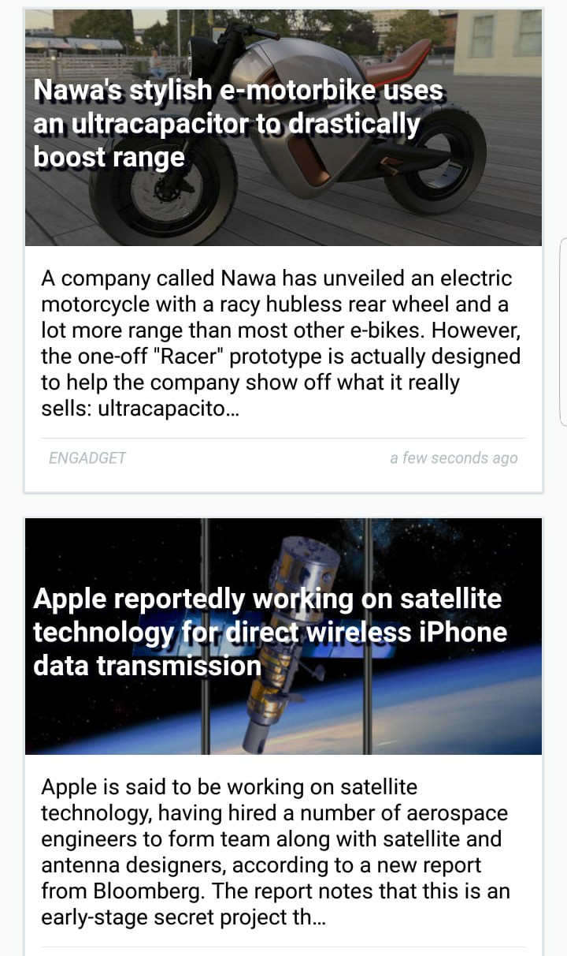
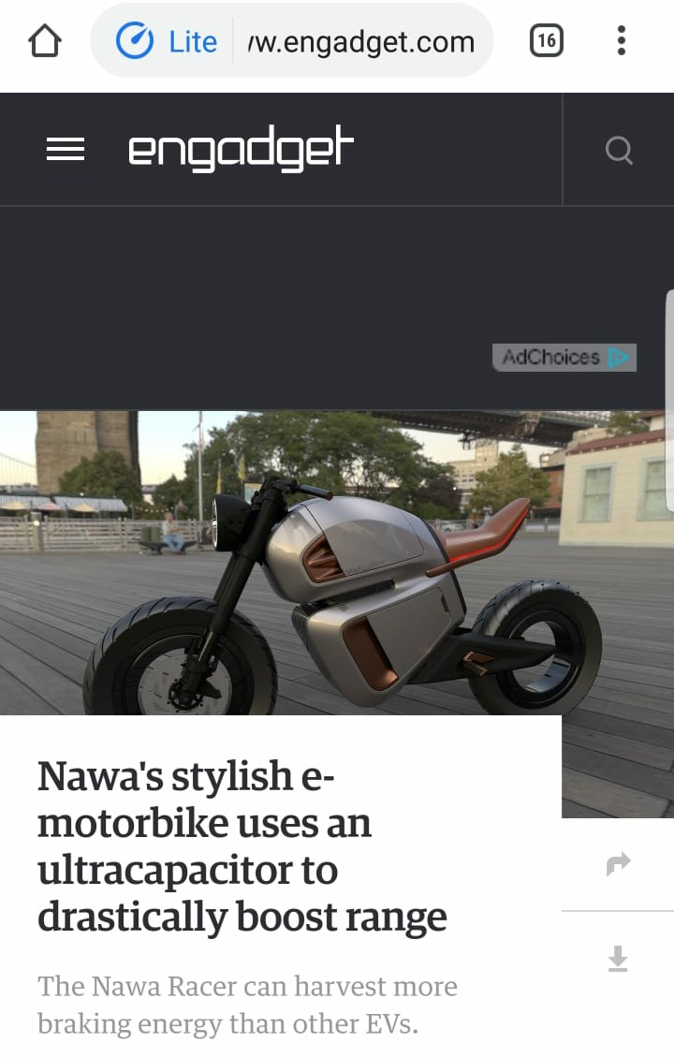
APP layout
This page gets loaded in the browser as we click on our first headline shown in our app layout.

Slide 6
Future horizons
Login page can be added and by using database we can store each user recommendation and most visited news or pages and show each user his most interested news on top.
The news would display according to the selected category from the navigation.

Slide 7
Questions

